Slide 1
Data visualization
Lectures are available online at
http://github.com/a-vodka/dv

Slide 2
History visualization DATA

Slide 3
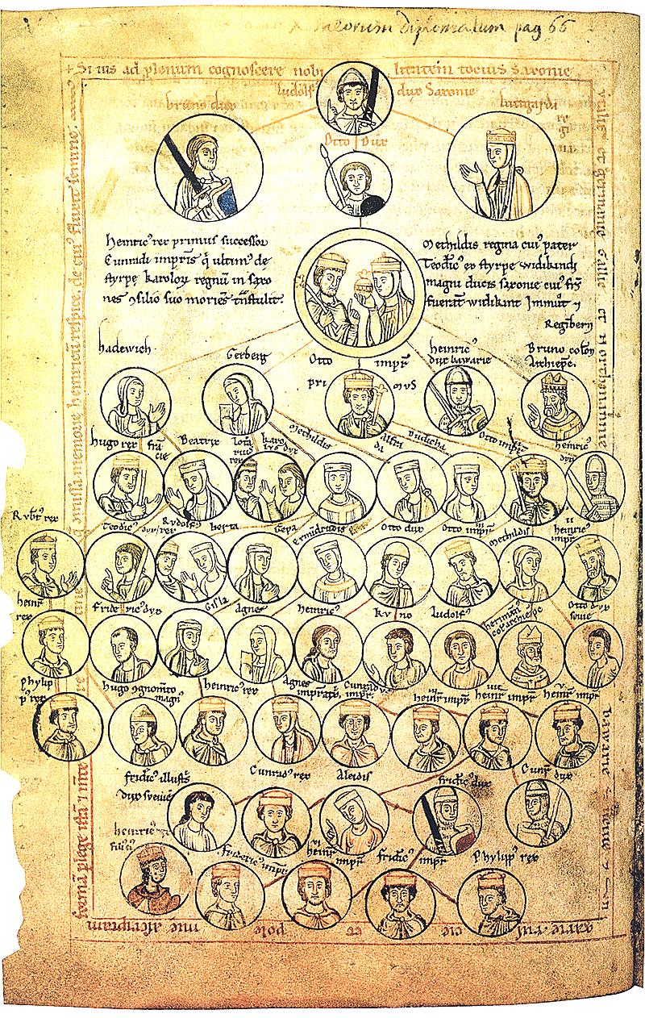
Trees
Genealogical tree of the Saxon dynasty in the manuscript XII century a

Slide 4
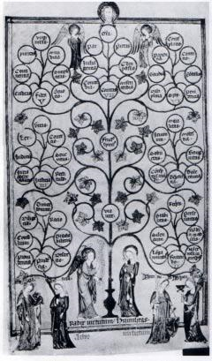
Trees
Tree of Virtues ( XIV century)

Slide 5
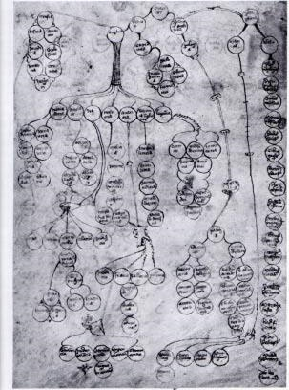
Trees
Tree of sins ( XIV century)

Slide 6
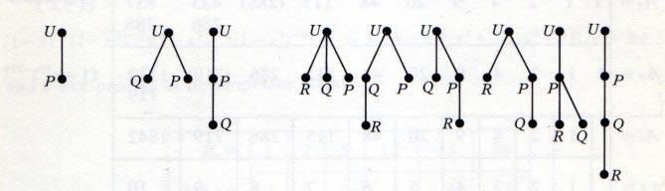
Trees
Marked trees from Kaley's article (1857) about trees .
A. Cayley. On the Theory of the Analytical Forms Called Trees. Philosophical Magazine, 4(13):172–176, 1857.

Slide 7
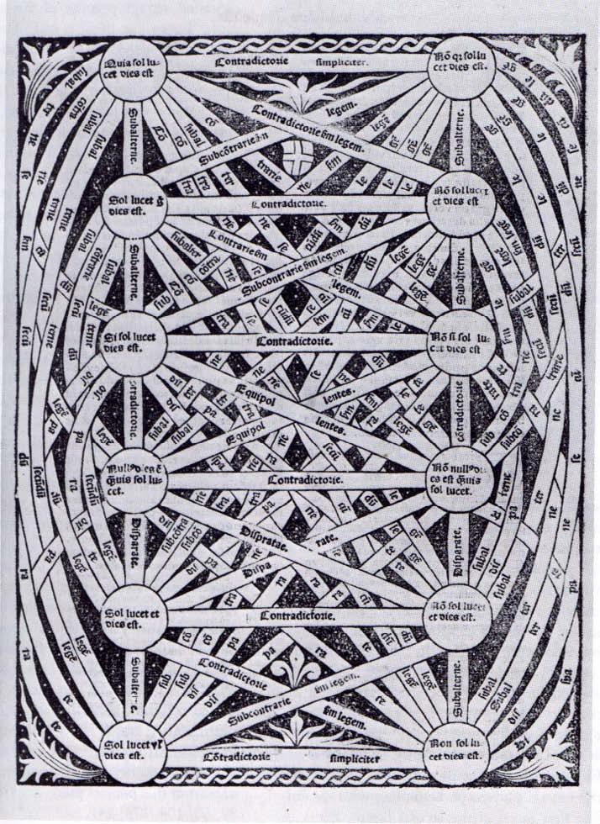
Graphs
A logical square is a diagram of relationships between syllogisms. Juan de Celaya (1490—1558)

Slide 8
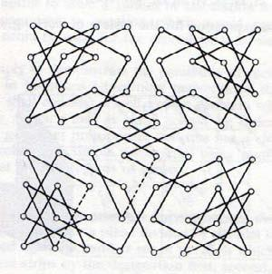
Graphs
Illustration by A.-T. Vandermond (1771) to the problem of a horse walking around a chessboard.

Slide 9
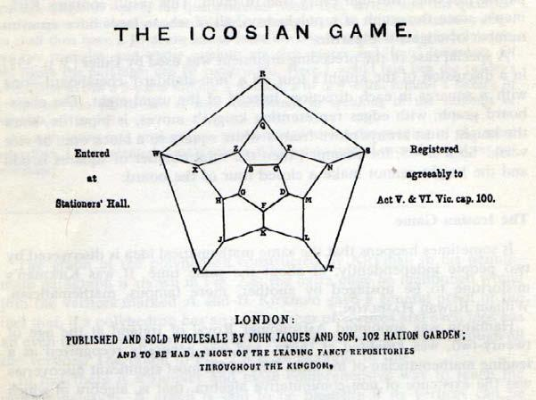
Graphs
Illustration by U. Hamilton (1857) to the problem of circumambulating the icosahedron

Slide 10
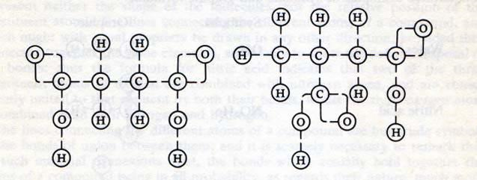
Graphs
Graphs of molecules from the article by A.K. Brown (1864).

Slide 11
Early articles on visualization
HW Tutte '1963 How to draw a graph
DE Knuth '1970 How shall we draw a tree

Slide 12
Symposiums on Graph Drawing
International Work Meeting on Graph Drawing, Marino (Rome), Italy, June 4—5, 1992
…
21st International Symposium on Graph Drawing, Bordeaux, France, September 23—25, 2013
22nd International Symposium on Graph Drawing, Würzburg , Germany, September 24-26, 2014

Slide 13
D. Knut on the visualization of graphs
DE Knuth (GD' 1996):
Graph drawing is the best possible field I can think of : It merges aesthetics, mathematical beauty and wonderful algorithms. It therefore provides a harmonic balance between the left and right brain parts .
A good graph drawing algorithm should leave something for the user's satisfaction.

Slide 14
Typical areas of application of graphs
Software engineering: UML diagrams, call diagrams;
Biology: genomics , food chains, ...;
Networks: network management tools, Internet;
Security: network attacks;
Social networks : Twitter , Facebook , etc.

Slide 15
User requirements
Readability : the main structural features of the graph are visible;
Conformism : the drawing must conform to style conventions specific to a specific application area;
Manageability : the user can control the styling parameters;
Speed corresponds to the goal (dynamic graph on the screen / high-quality diagram for printing / ...);

Slide 16
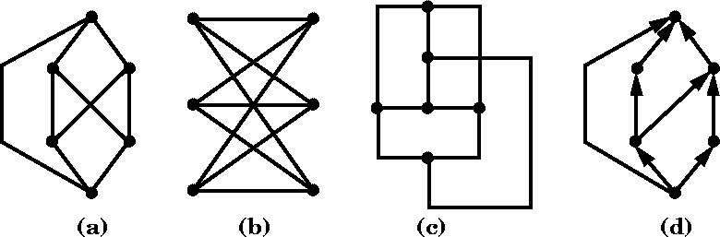
Conventions​
Agreement is a property that the nesting of the graph must satisfy "unquestionably", otherwise the graph is not considered nested at all. Examples :
The vertices of the graph should not lie on the edges, the ends of which they do not meet .
How edges can be represented (by a line segment / polyline / circular arc / spline / ...)
How the vertices should be located (if an edge goes from 𝑢 to 𝑣, then 𝑣 lies below 𝑢 / the vertices and bends of the edges should have integer coordinates / ...).

Slide 17
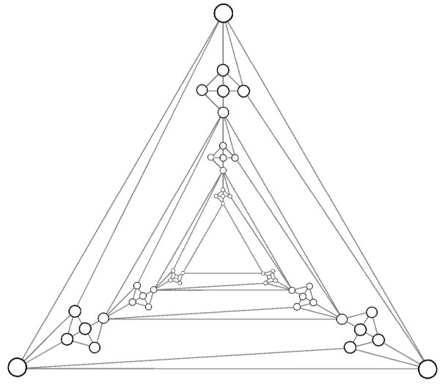
Conventions​
A rule is a wish that should be fulfilled as much as possible. The rules have, mainly, an aesthetic motivation . Examples:
Curves depicting ribs should be shorter.
The number of bends on the edges should be smaller .
The number of crossed edges should be smaller .
Vertices should not be too close .
The angles between intersecting edges are larger .
The laying area is smaller .
Symmetries of the graph should be traced.

Slide 18
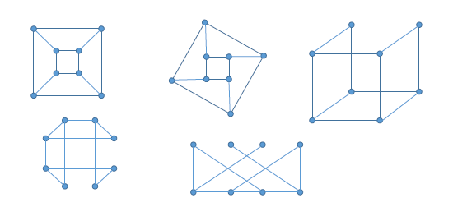
There is often no such thing as a "best" style

Slide 19
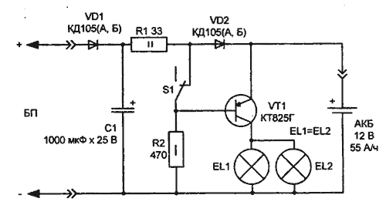
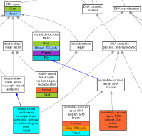
Difficulties in visualizing real graphs
People don't want to draw graphs .
T hey want to draw pictures that contain graphs.
Brendan Madden, 2003
A real graph has semantics → semantic rules appear.

Slide 20
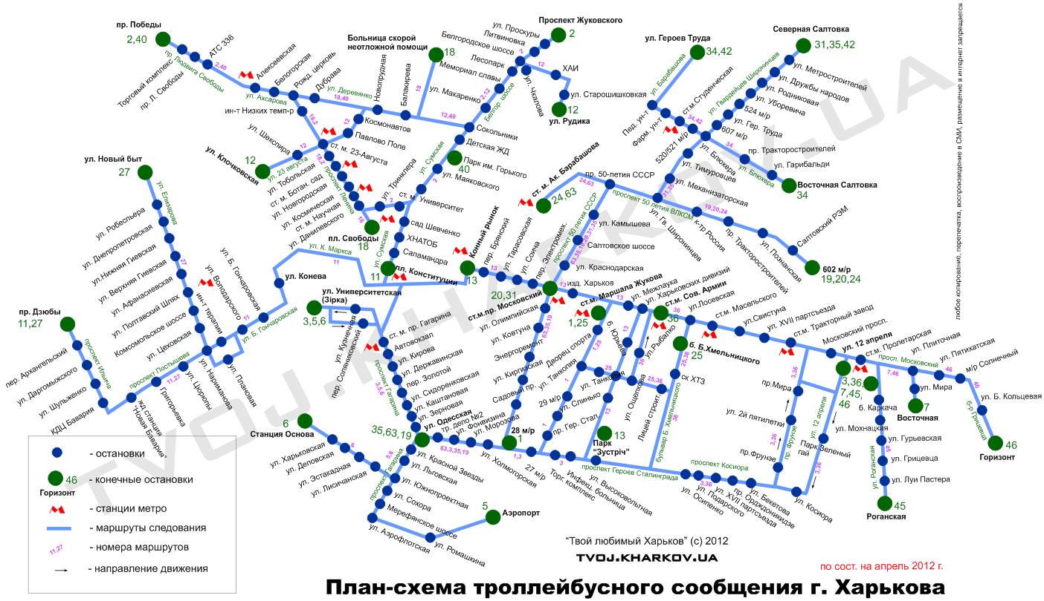

Slide 21
Difficulties in visualizing real graphs
Examples of semantically dictated rules :
Selected vertices should be located nearby .
Selected vertices must be located on one straight line .
Selected vertices should be located in the center of the drawing .
Selected vertices should be located on the periphery.

Slide 22
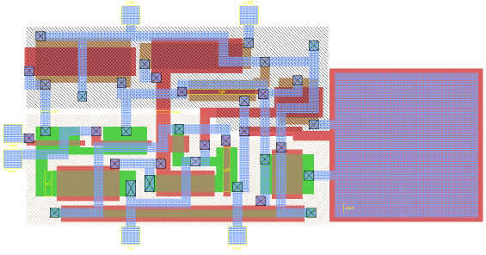
Stacking of super-large integrated circuits
It is even more complicated than laying out graphs: there are many additional technological rules.

Slide 23
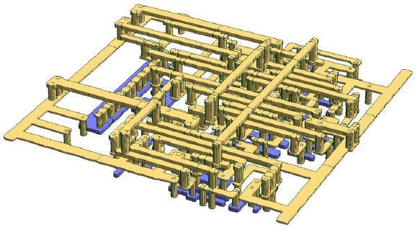
Tracks on the board

Slide 24
Technical approaches to visualization
Topology → form → metric
Methods based on stacking planar graphs
Power methods
Divide and conquer methods

Slide 25
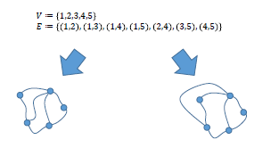
Topology → form → metric
The "topology" stage: we determine how the edges around each vertex are ordered.

Slide 26
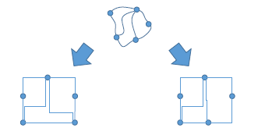
Topology → shape → metric
The "shape" stage: we determine the shape of the edges. (In the case of orthogonal ones, the number of fractures is represented.)

Slide 27
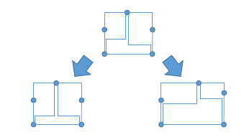
Topology → shape → metric
The "metric" stage: we select all lengths .

